Slide 1







Voice Based Patient Call System
Infosys Springboard Internship 5.0
Presented by: Team B3 batch
Mentor : Ms.Shilpee

Slide 2


WHY IS IT NEEDED ?
Delayed response time
Insufficient Workflow
Faster Response
Real-Time Alerts
Voice Based Assistance
Outdated Call Systems

Slide 3


Objective
Real-time Tracking and Notifications : Enables healthcare providers to monitor patient status and receive timely alerts for critical situations.
AI-Powered Prioritization : Utilizing AI algorithms to analyze patient data and dynamically prioritize their needs.
Fast Communication Channel : A robust communication infrastructure for real-time interaction between patients and healthcare providers.

Slide 4



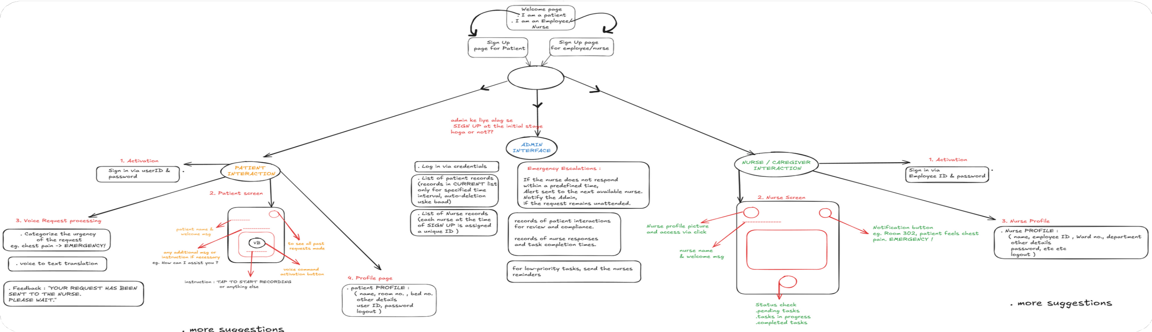


USER FLOW

Slide 5
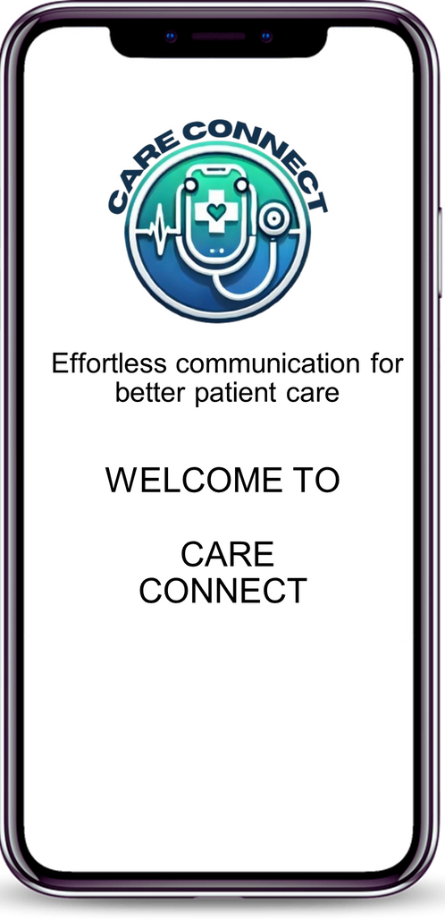



Care Connect
Voice-Based Patient Calls
Request classification to High, Medium and Low
User-Friendly Mobile Interface Instant Alerts for Nurses & Caregivers
Role-Based Login for Patients & Nurse Speech Services Integration
NLP-Powered Request Analysis

Slide 6
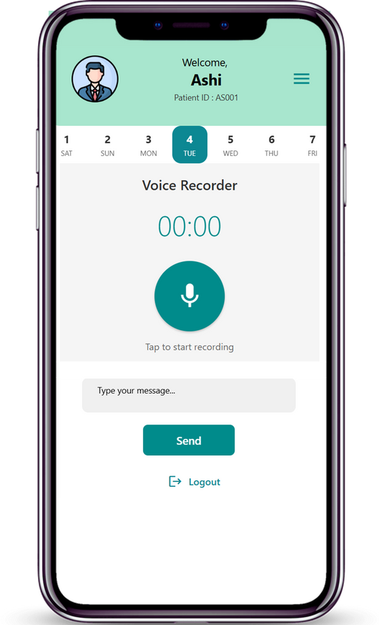
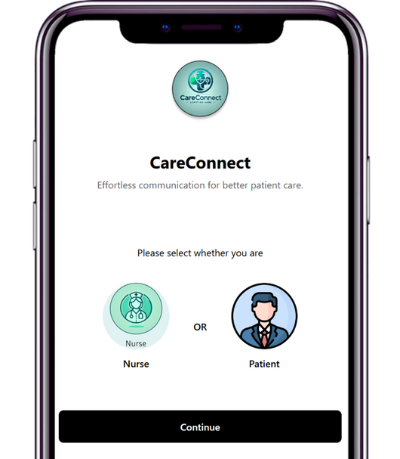
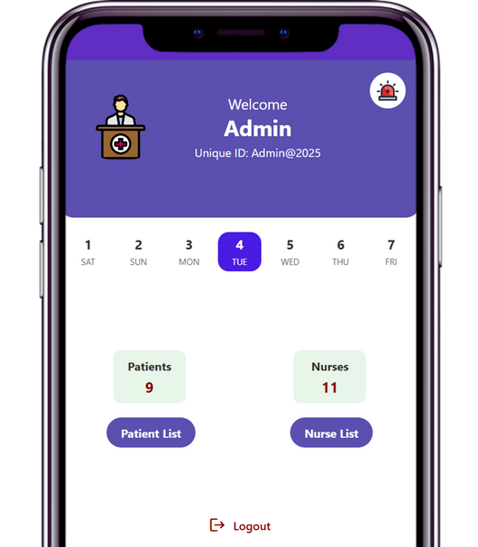
APP UI

Slide 7












TECH STACK
Figma
App UI designing
React - Native
Front-end development
Expo Go
Bundling the app
Android Studio
Testing & debugging
Node JS
Building Back-end server
Azure
AI, NLP, speech to text
Mongo DB
Backend Data storage
Express JS
Creating RESTful APIs

Slide 8
CHALLENGES :
Accurate Speech Medical Jargon Scalable Database
Displaying Real-time Requests
SOLUTIONS :
Azure Speech Services Fine-tuned the NLP model
MongoDB Atlas with flexible schema
CHALLENGES

Slide 9


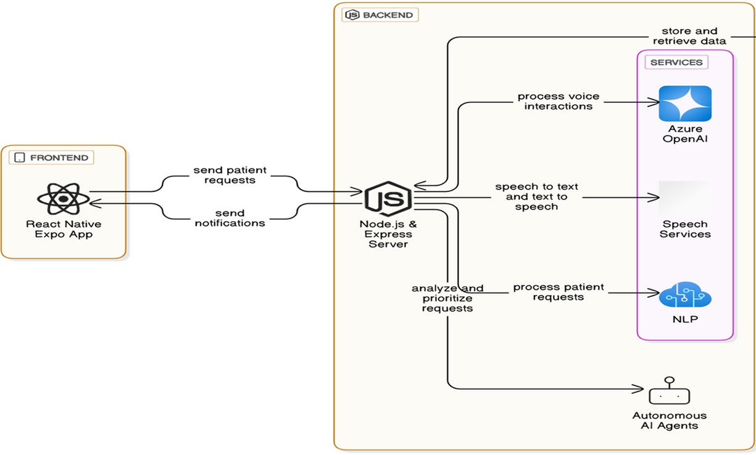

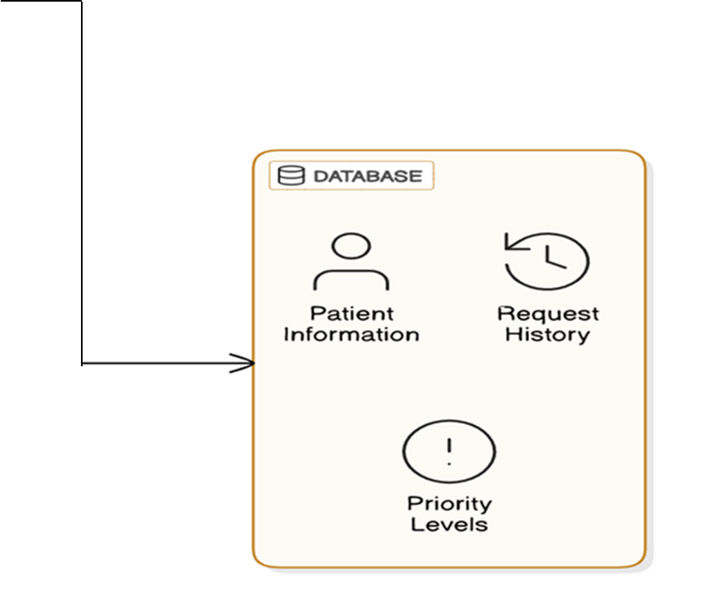
SYSTEM DIGRAM

Slide 10
SCOPE
Integration with IoT Hospital Systems : Connect with IoT devices like patient monitors and wearables to provide real-time health updates and automated alerts.
Multi-Language Support : Extend the app to support multiple languages, catering to patients from diverse linguistic backgrounds.
AI-Powered Predictive Alerts : Implement machine learning models to predict emergencies based on patient health data trends, generate proactive alerts and recommend preventive measures.
Virtual Assistant for Chronic Conditions : Provide personalized support and guidance for patients with chronic conditions.

Slide 11

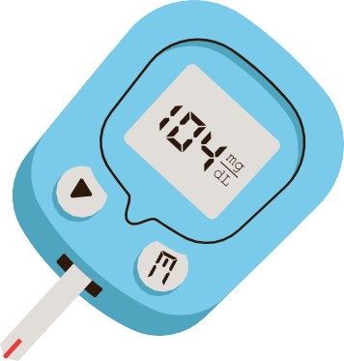

THANK YOU!

